Slide 1


Step-by-step Interview
INTERNATIONAL AGENCY FOR RESEARCH ON CANCER LYON - FRANCE
e-SMP

Slide 2

Introduction
24-h recall
Feedback step-by-step interview
Step-by-step Interview
IARC, Lyon - France
GloboDiet training:

Slide 3


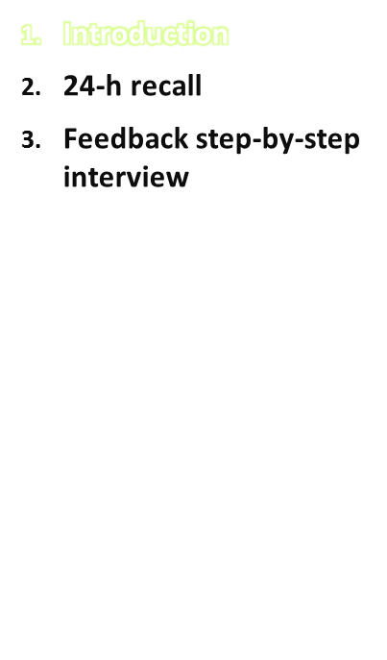
A DEMO interview will be used to demonstrate to the trainees how a real interview is to be conducted. It touches on all the different aspects of the 24-h recall
30 min step-by-step DEMO interview has been recorded
This interview will be shown and commented on afterwards
Step-by-step Interview
IARC, Lyon - France
GloboDiet training:

Slide 4
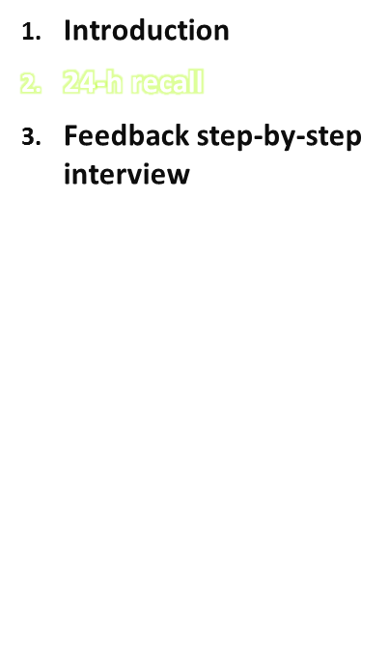
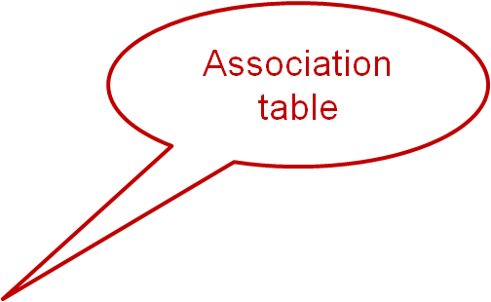


Woke up at 6:30
Before breakfast at 6:35 am (at home):
cup of tap water (P47)
Breakfast at 7:30 am (at home):
  1 container of yoghurt (organic, plain, Tesco brand) with muesli (fruit & nuts muesli P41: 1/2 bowl) and honey (I don’t know how much)
  1 cup of fruit tea (P48: 5/6 fraction) with sugar, white (unit: 1 cube)
Morning snack at 10:30am (at work):
  1 cup of black coffee (n.s.) (P51) with milk, normal (quantity unknown: not measured: a cloud)
  ½ banana (medium size)
Step-by-step Interview
IARC, Lyon - France
GloboDiet training:

Slide 5

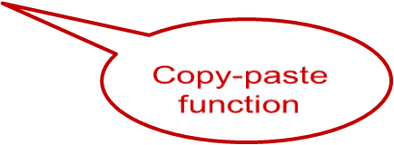
24-h recall
Lunch at 12:30pm (at work):
  beef steak, fillet (150g): all descriptors undefined or cooked n.s. (P42)
  potatoes: all descriptors undefined or cooked n.s. (P001)
  a side dish of steamed broccoli: all descriptors undefined or cooked n.s.; unit: 4
  florets
  1 Twix bar: 2 fingers
  water
Afternoon snack at approx. 4pm (at work):
  2 pieces of white bread (n.s.) (S056: fraction 2; thickness: 2.5 cm)
  jam n.s. (use bread shape and picture to quantify) S056: fraction 1; thickness P59
  fruit tea (copy of breakfast)
GloboDiet training: Step-by-step Interview
IARC, Lyon - France

Slide 6
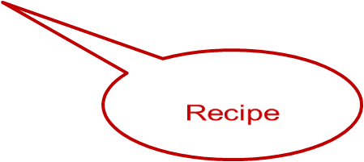
24-h recall
Dinner at 8pm (with friends):
  vegetarian lasagna at a friend’s house – unknown/undefined (with
  mushrooms, instead of courgette in the recipe) Photo. Change
  courgette for mushroom n.s. undefined ….
  1 small bottle of red wine (unit 200 ml)
  Dietary supplement was consumed during breakfast!
General comment: The interviewer started “New Interview” after explaining the study to the subject first, so the clean interview time is recorded
GloboDiet training: Step-by-step Interview
IARC, Lyon - France

Slide 7
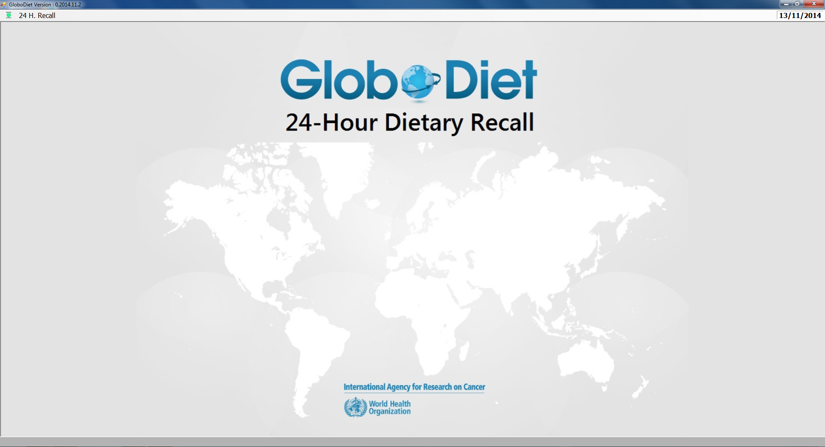
DEMO interview
GloboDiet training: Step-by-step Interview
IARC, Lyon - France

Slide 8
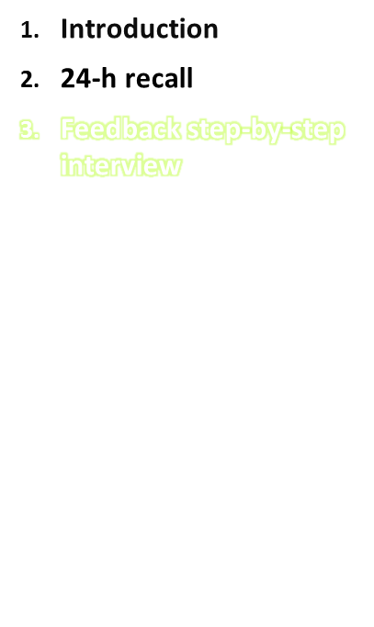
In the step-by-step interview, some mistakes against the general interview techniques that were recommended were made. What are the mistakes that you observed?
Step-by-step Interview
IARC, Lyon - France
GloboDiet training:
Notes:
For the trainer: the mistakes have been listed in a word document that you should use as a cross-check

Slide 9
Feedback step-by-step interview
Specific remarks about interview techniques that could be improved:
Take note of the vitamin C during the QL step to avoid asking again at the dietary supplement step: a reminder will pop up to avoid asking again: the interviewer starts with that information, not from scratch
Lunch at work: the option “restaurant etc.” should have been chosen since it was a hot meal (most likely from a catering while in the interview the option “work (no catering)” was chosen).
Was it cow milk?: leading questions
QLI=yoghurt with muesli, so no need to ask if something was eaten with the yoghurt: directly ask detail about the muesli
Muesli: brand name could not be found → the interviewer should add a note in this case! Not just use something similar
Honey added to muesli with yoghurt: not necessary to ask whether the honey was added to both items since it was clear that the honey was added on top of the muesli with yoghurt.
GloboDiet training: Step-by-step Interview
IARC, Lyon - France
Notes:
It is important to note that it is in de benefit of the dieticians/interviewers and data managers to keep the brand name lists as up-to-date as possible to avoid extra time for handling unnessesary notes!!! In the Netherlands interviews do not have to make notes if Brand name is missing for muesli → the brand name list was updated with the new brand names before the interviewers started the interview (so in the version to be used in the fieldwork).

Slide 10
Feedback step-by-step interview
Specific remarks about interview techniques that could be improved:
Was it beef steak: leading question
In afternoon snack it was not asked what kind of jam that was used (this was because of the fact that the UK version that was used does not include different types of jam, while this will be the case in most other GloboDiet versions)
Check the size of the cup (any HHM) with the subject (e.g. against the ruler). “Similar cup” does not mean “same cup”. Check the size of the banana, medium banana may not mean the same to everyone – check with the standard unit’s dimensions, if available.
Show the bread shapes in the picture book, small, medium, large is not enough.
Add a note for the cloud of milk, so that quantity=? can be replaced after the interview.
Maybe group “steak, potatoes, broccoli” under the same QLI in case some sauce was added on top of all the plate (use of PCTFSS).
GloboDiet training: Step-by-step Interview
IARC, Lyon - France
Notes:
It is important to note that it is in de benefit of the dieticians/interviewers and data managers to keep the brand name lists as up-to-date as possible to avoid extra time for handling unnessesary notes!!! In the Netherlands interviews do not have to make notes if Brand name is missing for muesli → the brand name list was updated with the new brand names before the interviewers started the interview (so in the version to be used in the fieldwork).

Slide 11
Feedback step-by-step interview
Specific remarks about interview techniques that could be improved:
Avoid selecting generic items: coffee n.s. instead of “regular coffee”: what do you mean by regular? With caffeine? Espresso? Brewed? So enter a more specific item. Same thing for the mushrooms which substitute the aubergines: ask the type of mushrooms instead of entering n.s.
Avoid selecting too generic descriptors: the subject says boiled or steamed potatoes so “cooked without fat” is fine, not “cooked n.s.”
If case of a warning “exceeding quantity” for bread here, this has to be checked with the participant, not ignored/skipped.
Photo P001 of potatoes was shown to the subject and then the interviewer selected P002 instead..take care to click on the correct items.
It is not because the lasagna was eaten “at friends” (Place of consumption) that it was prepared “at friends” (preparation method). Do not make assumption, this has to be clarified with the participant.
GloboDiet training: Step-by-step Interview
IARC, Lyon - France
Notes:
It is important to note that it is in de benefit of the dieticians/interviewers and data managers to keep the brand name lists as up-to-date as possible to avoid extra time for handling unnessesary notes!!! In the Netherlands interviews do not have to make notes if Brand name is missing for muesli → the brand name list was updated with the new brand names before the interviewers started the interview (so in the version to be used in the fieldwork).

Slide 12
Feedback step-by-step interview
General remarks about interview techniques that could be improved:
Interviewer didn’t always remember what subject said
Be aware that the numbers that can be used in the picture book appear on the screen (this should be underlined orally during the train the trainer course) – page numbers (added to apear on the screens) can guide also
Be aware that the picture book would be shown in a printed format (not electronic form as shown in the video) and the subject could list through it freely to find and indicate the best quantification method for he/she consumed
Quantifying: be aware that the interviewer has to list the different options available for estimating the portion size, while it is up to the respondent to select the method that is most appropriate for him/her
Try to balance open and leading questions (sometimes it is difficult to avoid any leading questions in the interview)!
GloboDiet training: Step-by-step Interview
IARC, Lyon - France

Slide 13
Feedback step-by-step interview
Other important remarks:
At the end of the final quality check, the software asks for a confirmation whether a supplement was used and only then it can be registered when this supplement was consumed and what type and quantity of supplement that was used.
Be aware that the grams that appear on the screen often derive from calculations, so therefore there might be more decimals than needed, however, these figures can be rounded afterwards (no problem of false precision).
Be aware that the handling of the notes takes a lot of time, therefore many surveys try to limit the amount of notes and ask the interviewers to use the note function only if it is relevant and necessary for the data processing.
Error in the video: quantities of ingredients can be entered only for added ingredients (relative to the consumed portion), not when substituting.
GloboDiet training: Step-by-step Interview
IARC, Lyon - France

